Slide 1


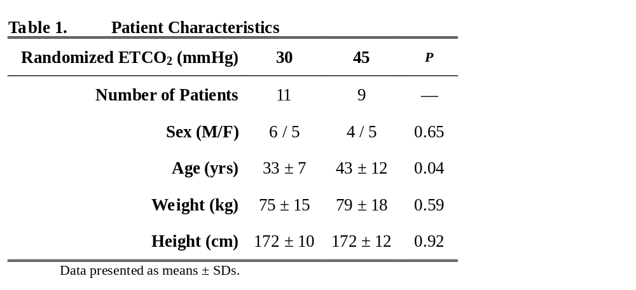
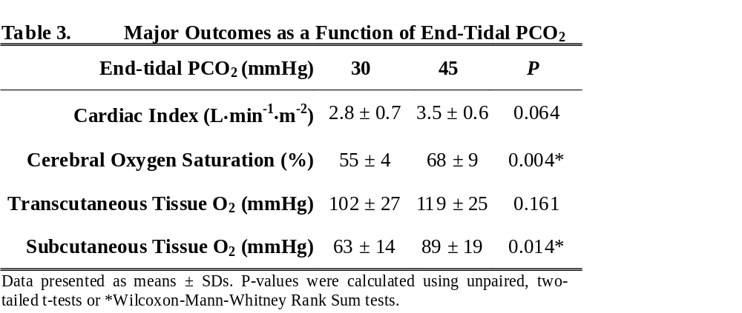
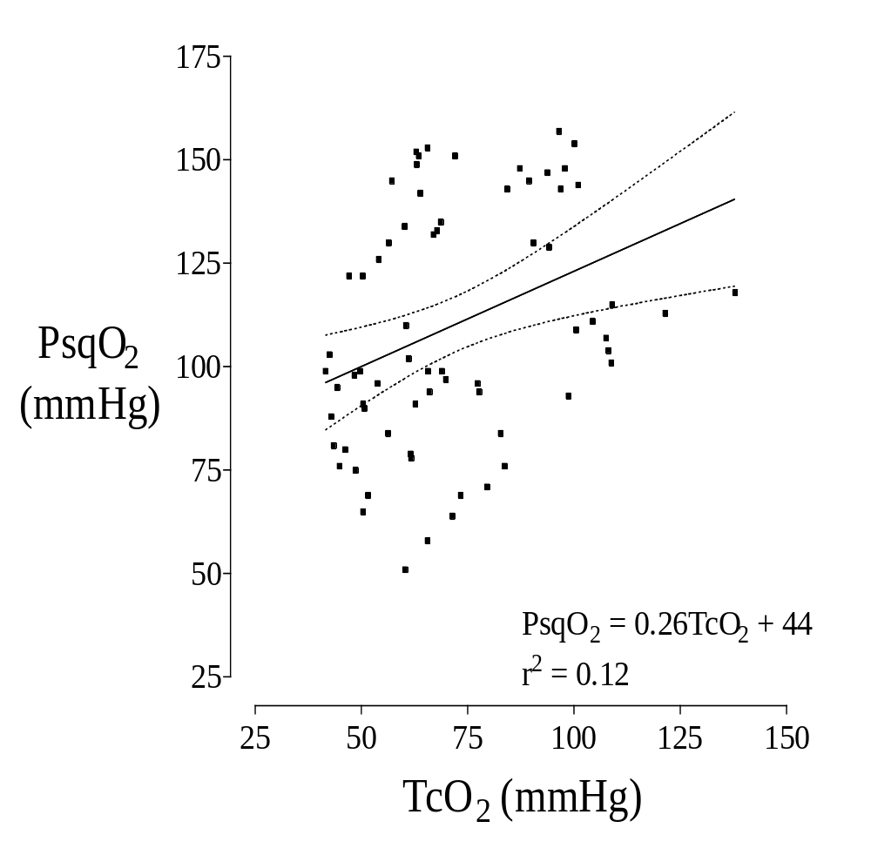
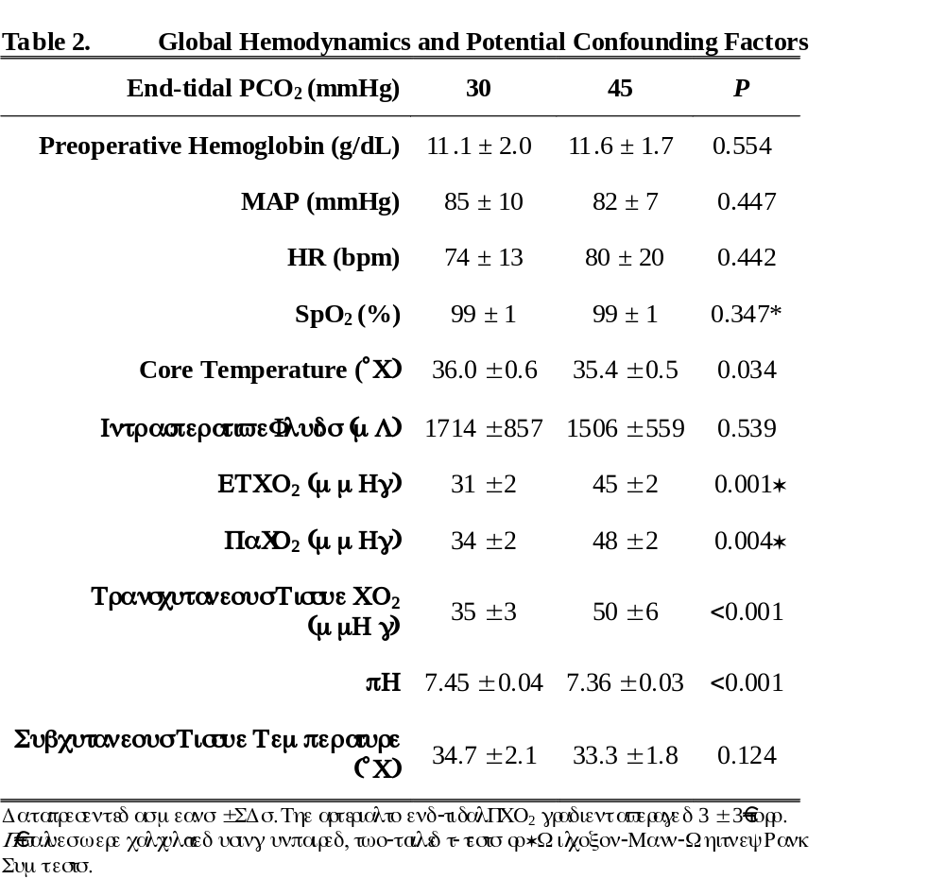
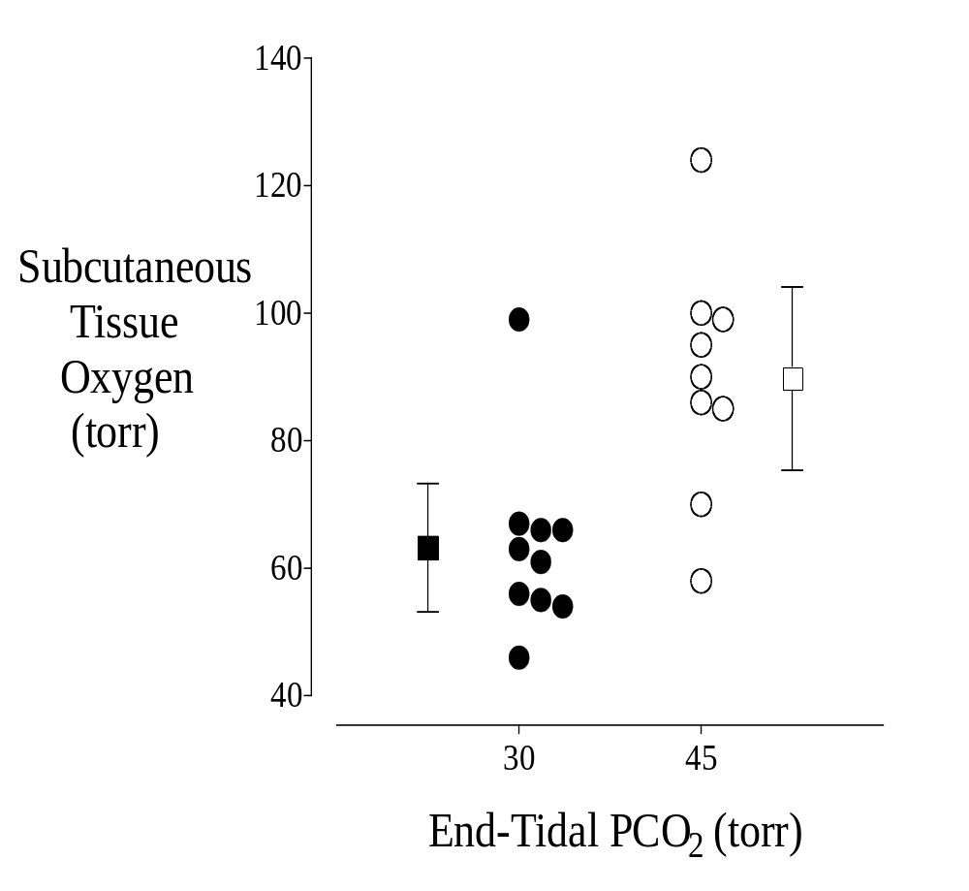
Intraoperative PCO₂ and Tissue Oxygenation
O. Akça, E.B. Liem, M.-I. Suleman, J. Fisher,* D.I. Sessler.
Outcomes Research™ Institute and Department of Anesthesiology, University of Louisville, KY; *Department of Anesthesiology and Physiology, University of Toronto, Ontario, Canada.
INTRODUCTION
RESULTS
Wound infections are common and serious surgical complications.¹⁻³ Oxidative killing by neutrophils is the primary defense against surgical pathogens and increasing intraoperative tissue oxygen tension markedly reduces the risk of such infections.^{4.5} We hypothesized that since moderate hypercapnia improves cardiac output and peripheral tissue perfusion, it would increase tissue oxygenation intraoperatively compared to normocapnia.
Figure 2
Figure 1
Correlation between subcutaneous (PsqO₂) and transcutaneous oxygen tensions (TcO₂). PsqO₂ = 0.26 • TcO₂ + 44, r² = 0.12
METHODS
CONCLUSIONS
20 ASA I-II patients undergoing abdominal surgery
Induced with propofol and sevoflurane in 40% O₂
Randomly assigned to intraoperative normocapnia (30 mmHg) or hypercapnia (45 mmHg)
O₂ tension measured with subcutaneous tonometer in lateral upper arm
Cerebral O₂ tension measured with cerebral oximeter probe (INVOS) on the forehead
Cardiac output measured with NICO
Data analyzed with t-tests or Wilcoxon-Mann- Whitney Rank Sum tests
P<0.05 was considered statistically significant
Mild intraoperative hypercapnia increased subcutaneous and cerebral oxygen partial pressures in surgical patients. Increases in tissue oxygen partial pressure similar to those observed in patients assigned to hypercapnia are associated with substantial reductions in wound infection risk. We thus conclude that mild hypercapnia may reduce the risk of surgical wound infection.
Subcutaneous tissue oxygen as a function of end-tidal PCO₂. Measurements were made on the lateral aspect of the upper arm with a polographic electrode system. The mean oxygen tension in the group receiving 45 mmHg, C0₂ was significantly greater (P=0.014) than the group receiving 30 mmHg.
REFERENCES
    1. Polk, HC, Simpson CJ, Simmons BP, et al.: Arch Surg 1983; 118:S1213-1217.
    2. Haley, RW, Culver DH, Morgan WM, et al.: Am J Epidemiol 1985; 121:206-215.
    3. Haley, RW, Schaaberg DR, Allmen SDV, et al.: J Infect Dis 1980; 141:248-257.
    Mishrike, SF, Law DJW, and Jeffery PJ: J Hosp Infect 1990; 16:223-230.
    Babior, BM: N Engl J Med 1978; 298:659-668

